Slide 1
CORE VALUES JUDGING
Bayou Builders

Slide 2
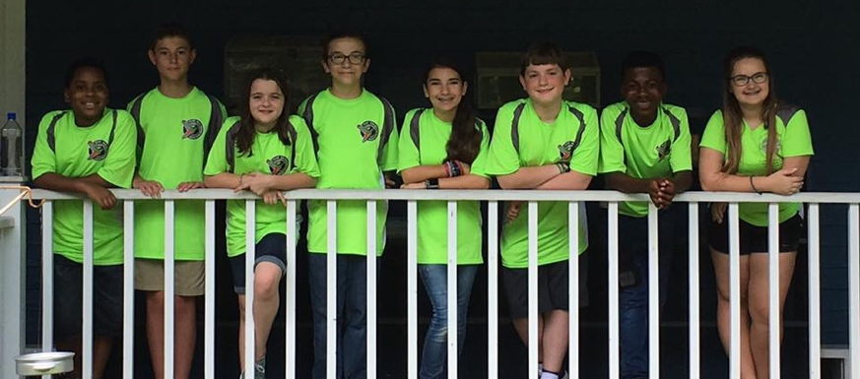
MEET THE TEAM
Bayou Builders are a 10-person, community-based team in Hammond, Louisiana.
They have won a Champions’ or Champion’s Runner-up award every year in their state and attended the North American Open, Razorback Open and World Festival.
In 2017, they were also nominated for the Global Innovation Award from Louisiana.
Bayou Builders are very involved in their community, giving hundreds of hours to outreach activities each year

Slide 3
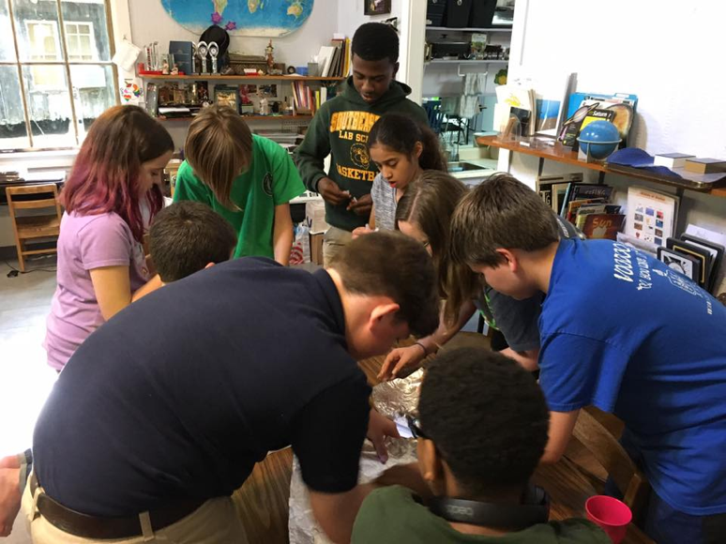
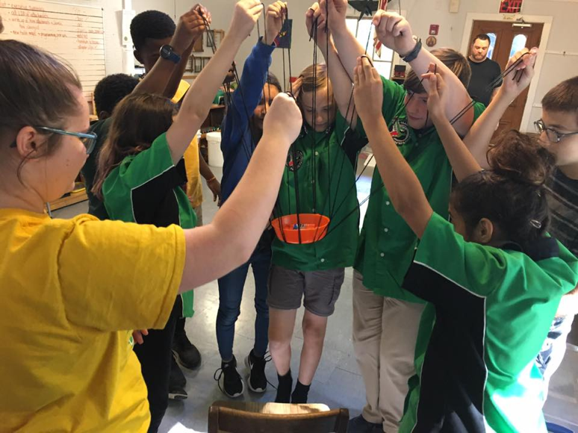
WHAT IS A TYPICAL JUDGING SESSION LIKE?
Core Values judging is a lot of fun. It’s your team’s chance to share its identity. It’s your chance to share your team goals and why being a part of FLL is important to you.
Judging typically begins with a team building activity. You will have a set time to complete the activity.
3

Slide 4
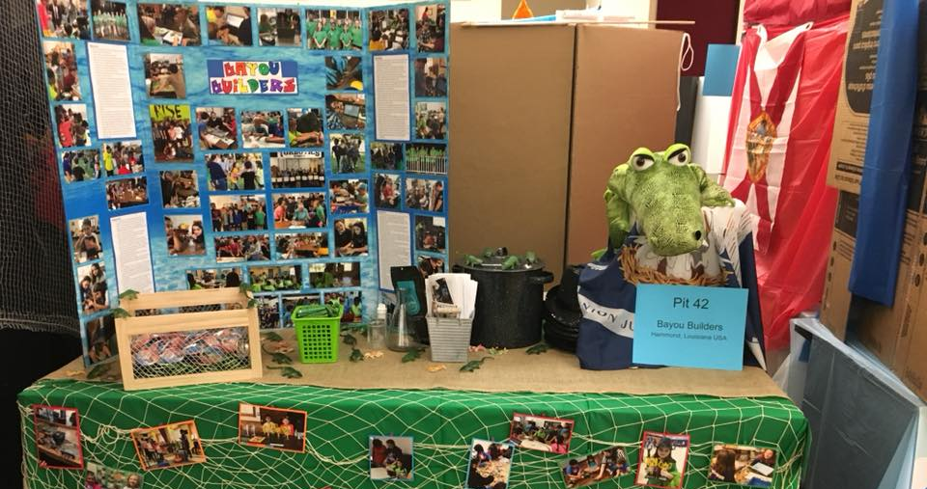
WHAT TO EXPECT IN CORE VALUES JUDGING
Following the activity, you will have a chance to give a brief presentation of your poster.
You want to leave as much time as possible to answer questions.

Slide 5
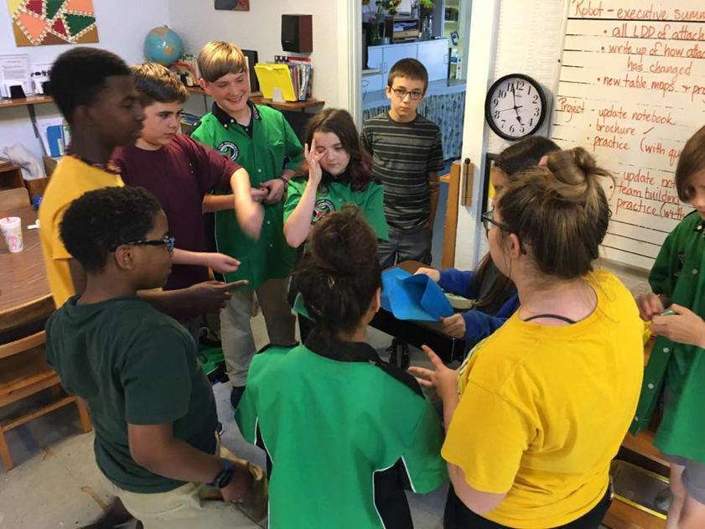
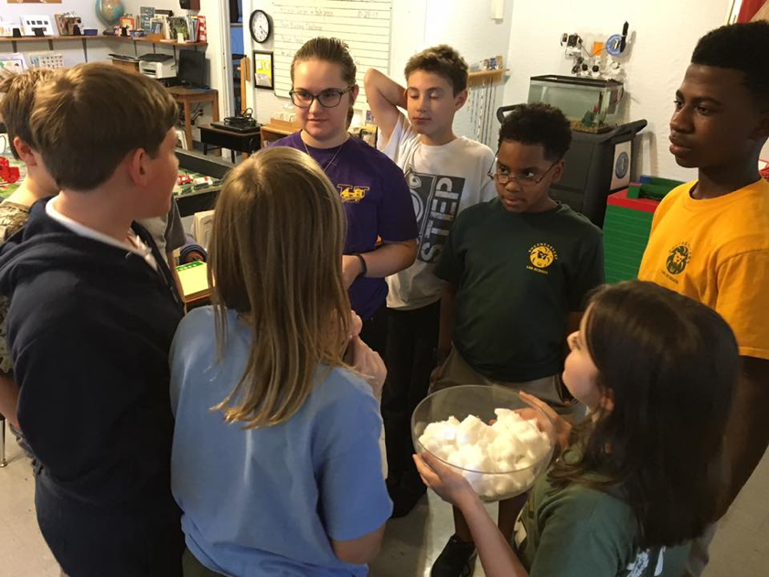
PREPARING FOR YOUR TEAM BUILDING ACTIVITY
When working with a large team, it helps to designate one person as the Team Building Mediator for each competition. This person assists in collecting ideas and makes sure every member is heard.
It’s also this member’s job to make sure everyone comes to an agreement and starts the activity.

Slide 6
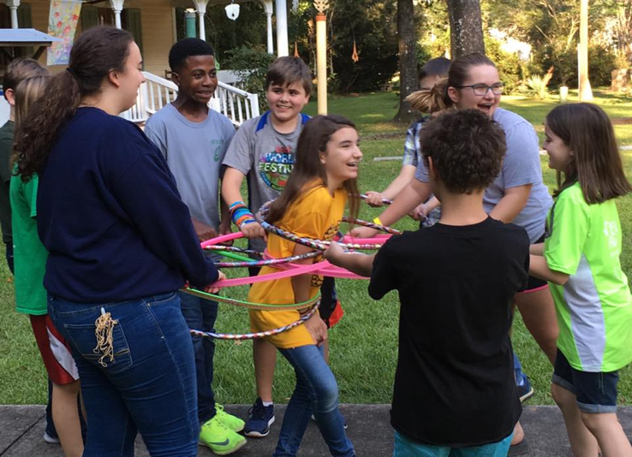
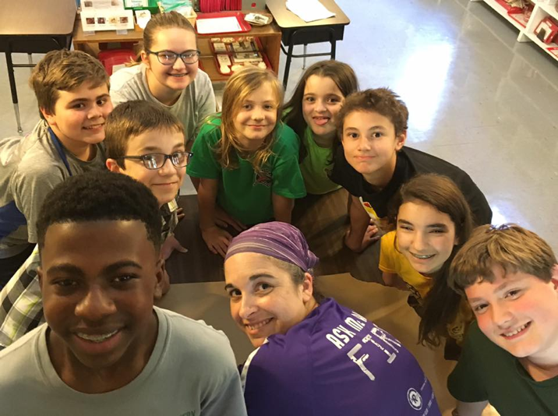
PREPARING FOR YOUR TEAM BUILDING ACTIVITY
Depending on how often you meet prior to competition, you should try to work on team building at least once a week. Choose activities that are fun and help members work on how they communicate and make decisions. This is also a great way to get to know each other.
You should always debrief for at least 5 minutes after each team building activity to develop continued goals.

Slide 7
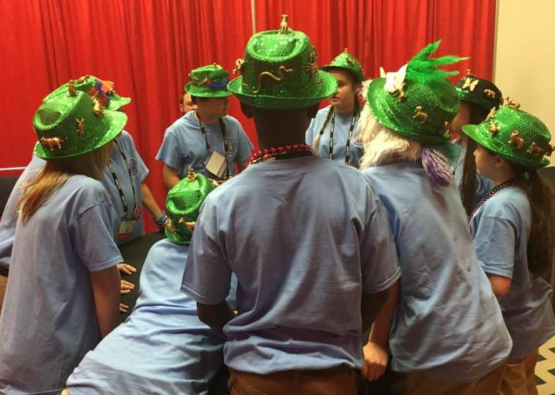
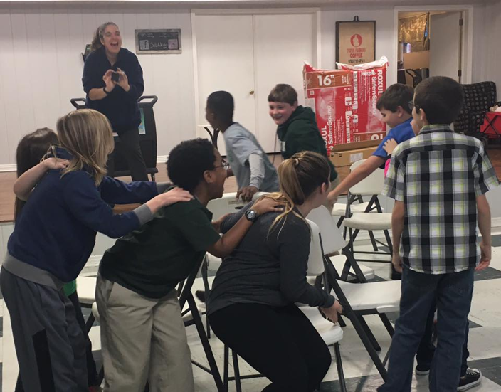
DURING THE ACTIVITY
You want to make sure you pay close attention to the directions given for the activity. If you don’t understand something or need to clarify, don’t hesitate to ask questions.
Spend about a minute sharing ideas and voting on a plan. Make sure to review the plan before starting so that everyone understands his or her role.

Slide 8
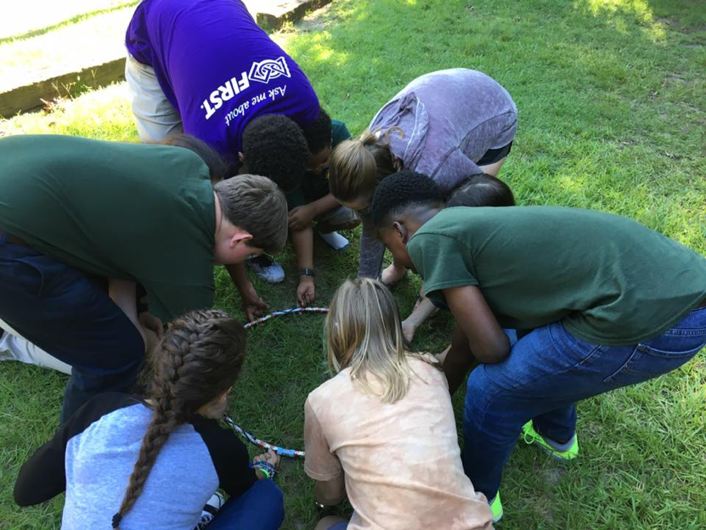
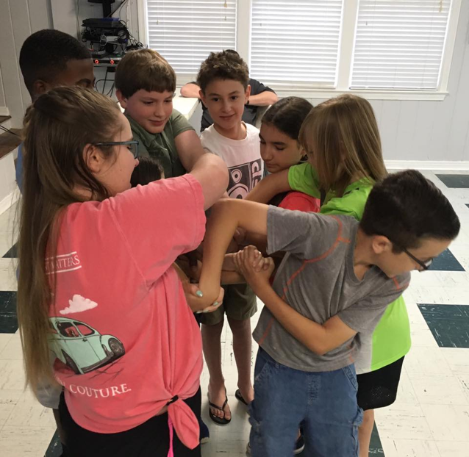
WHAT IF YOU DON’T FINISH THE ACTIVITY?
It’s okay if you don’t finish the activity. Sometimes you might not. The purpose of the activity is to give judges the chance to see how you relate to one another.
The important part is to include everyone on the team equally in the process and have fun.

Slide 9
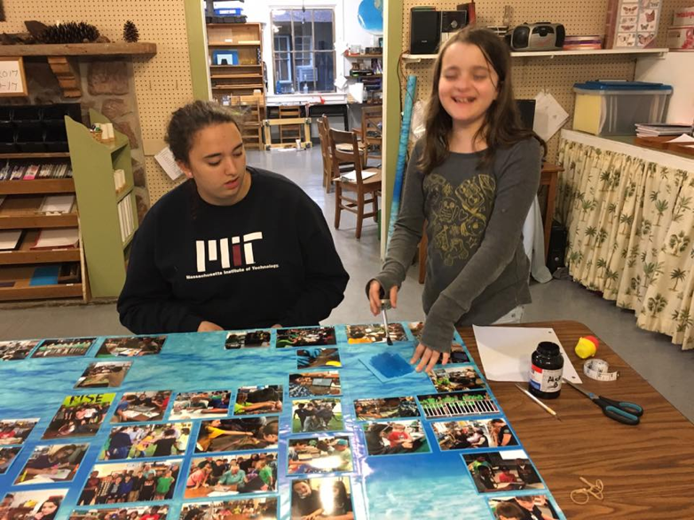
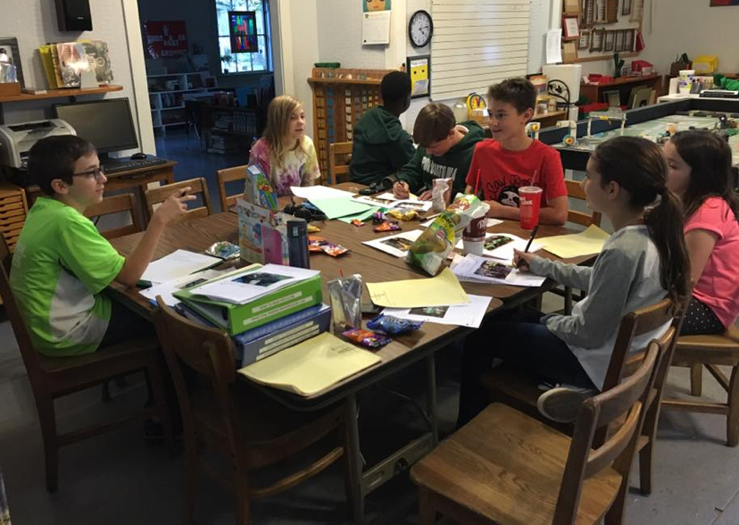
PREPARING YOUR CORE VALUES PRESENTATION
Make sure to reference the Core Values Judging Rubric when completing your poster and deciding on your presentation.
Some teams choose to prepare a scripted presentation, skit, song or cheer. This is your chance to share the best of your team with others.

Slide 10
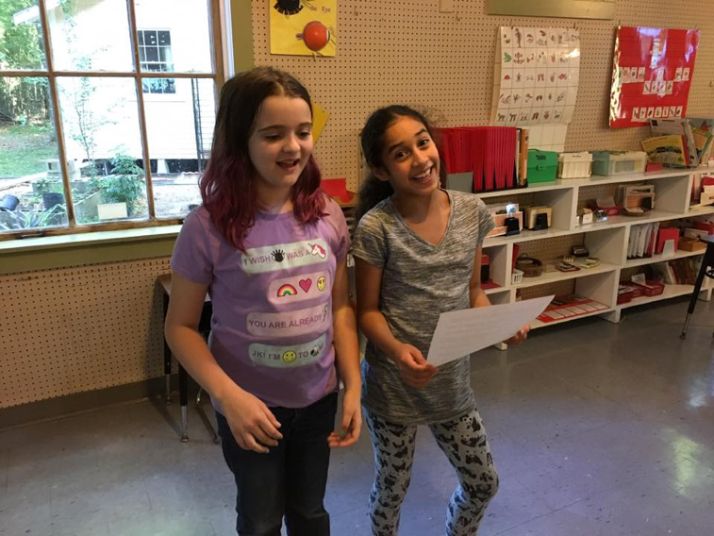
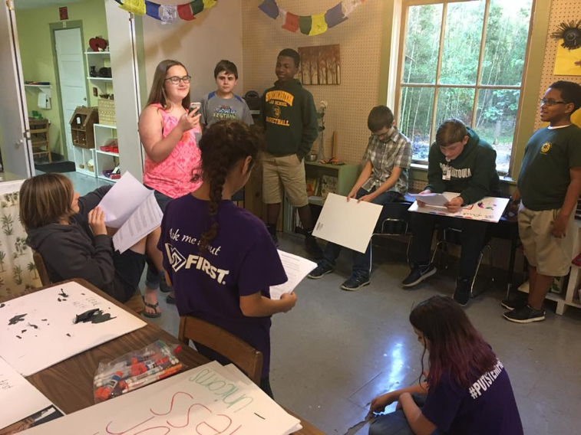
PREPARING YOUR CORE VALUES PRESENTATION
Practice your presentation as much as possible; focus on maintaining eye contact and speaking clearly at a moderate rate.
Be sure to include lots of pictures on your Core Values poster. It’s great for judges to see and can help remind you of things you want to say if you become nervous.

Slide 11
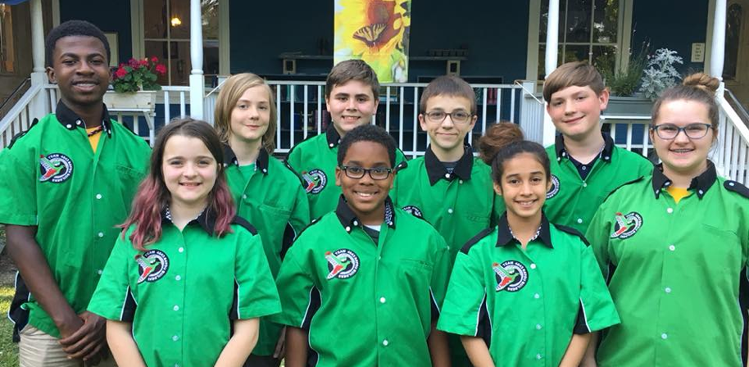
PREPARING TO ANSWER JUDGING QUESTIONS
In the days leading up to competitions, practice answering questions. Everyone should practice answering multiple questions.
Participate in discussions where you reflect on your season so far. Some of these questions might include:
What have been our goals this season?
Does everyone on our team have a specific job or do all work equally on project and robot?
How do we make decisions?

Slide 12
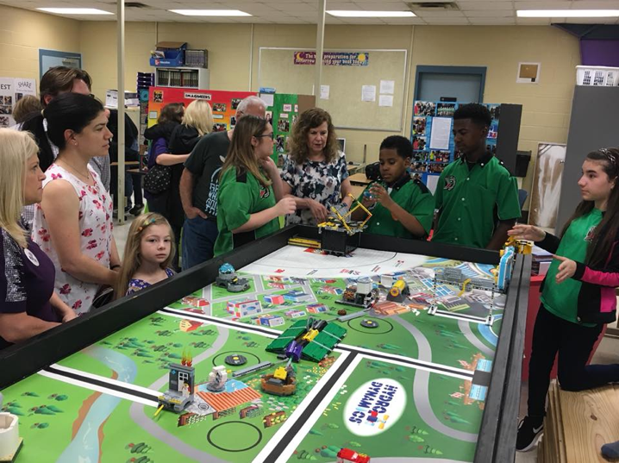
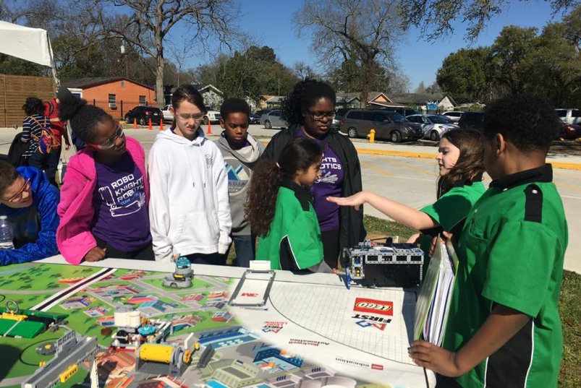
FINAL THOUGHTS...
Be sure to share information about your community outreach and what you have done to share your FIRST experiences with others.
It’s important to keep documentation on all of your core values and community outreach activities. These can be kept in a binder or engineering notebook.

Slide 13

CREDITS
This lesson was written by the Bayou Builders (https://www.bayoubuilders.org/)
More lessons for FIRST LEGO League are available at www.flltutorials.com
Creative Commons Attribution-NonCommercial-ShareAlike 4.0 International License

